Slide 1
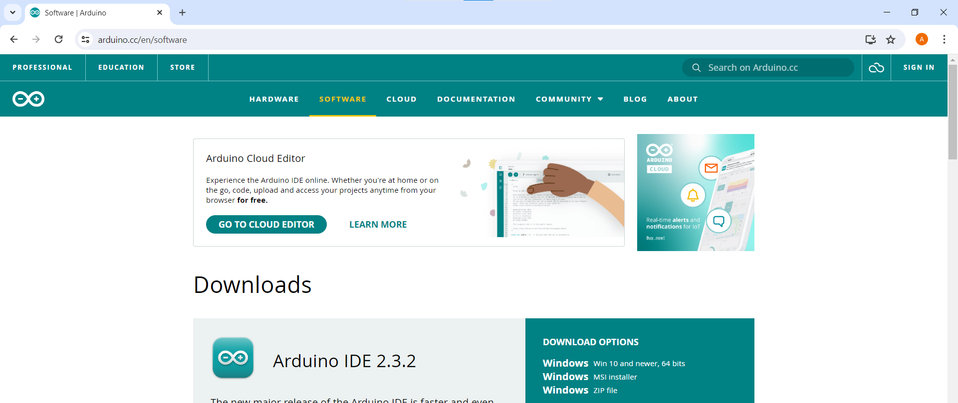
Open the URL arduino.cc/en/software and download the Arduino installer

Slide 2
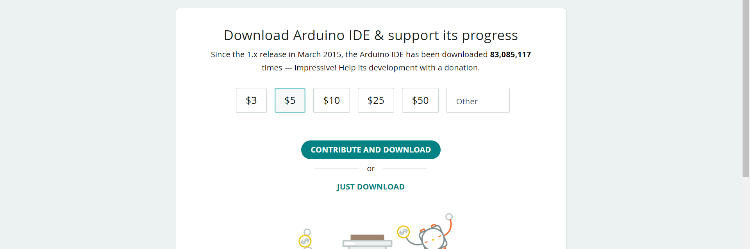
Click the JUST DOWNLOAD button

Slide 3
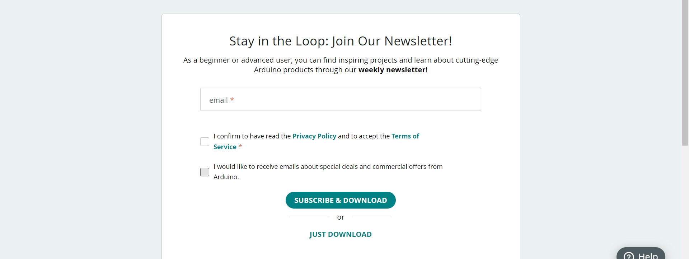
Same again...

Slide 4
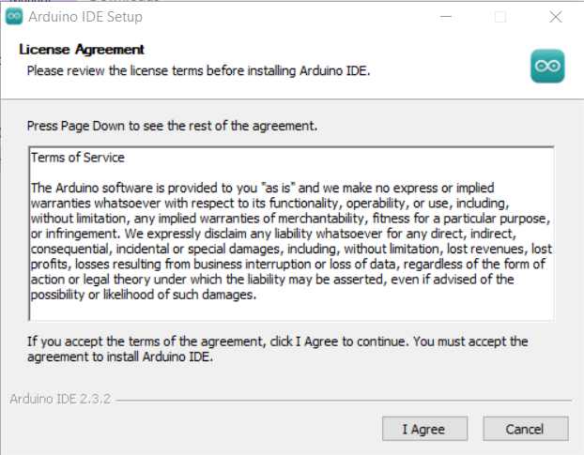
Click I Agree

Slide 5
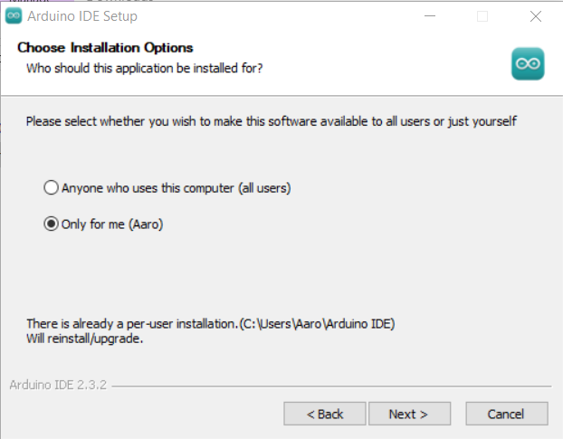
Click Next >

Slide 6
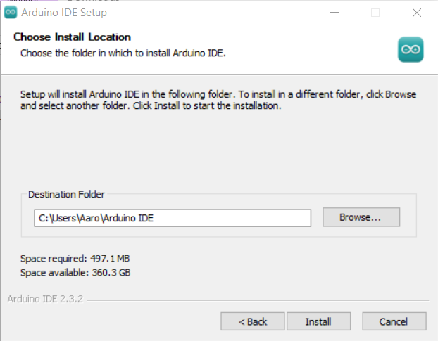
Click Install

Slide 7
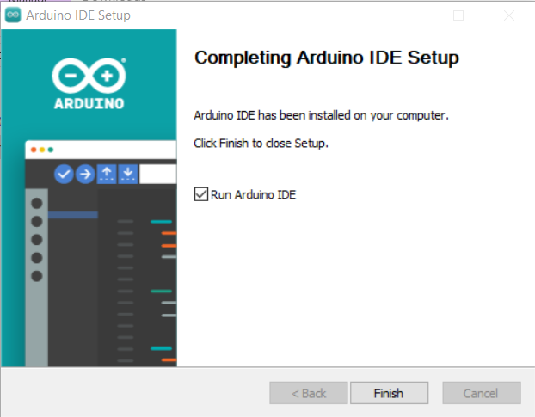
Click Finish

Slide 8
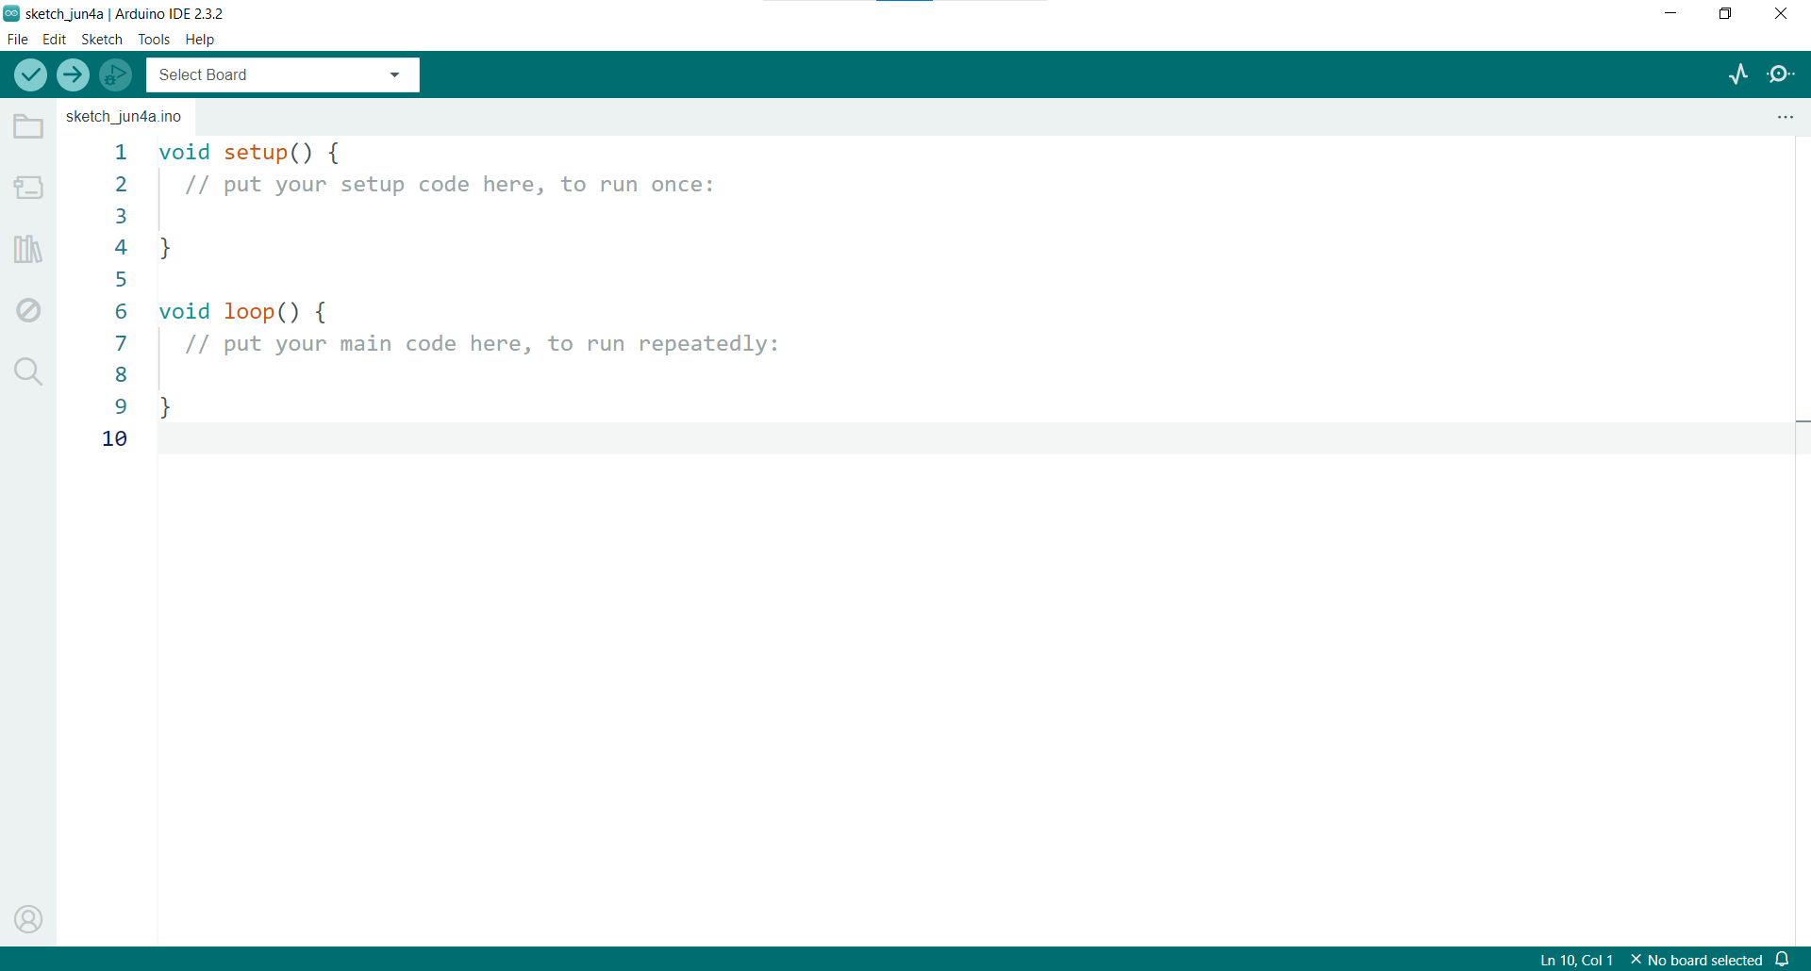

Slide 9
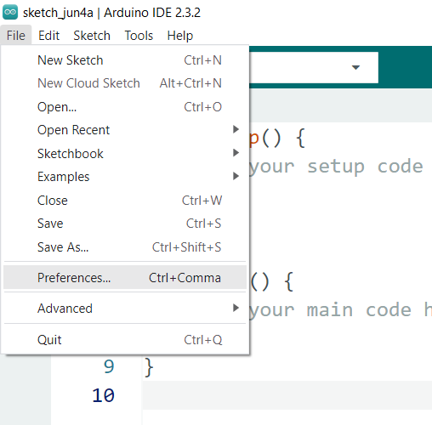
Open the Preferences from the menu (File > Preferences)

Slide 10
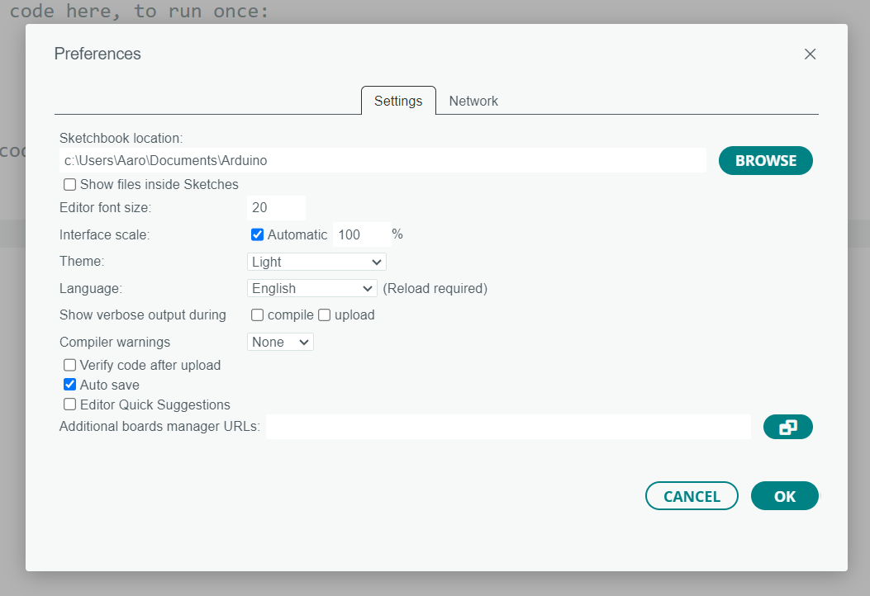
Set the font size at 20 and click the highlighted button

Slide 11
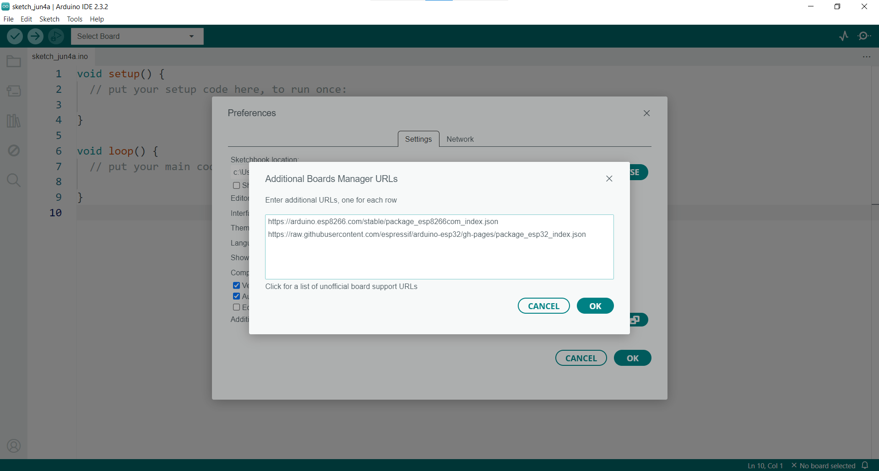
http://arduino.esp8266.com/stable/package_esp8266com_index.json
http://downloads.arduino.cc/packages/package_index.json
https://github.com/earlephilhower/arduino-pico/releases/download/global/package_rp2040_index.json
https://github.com/stm32duino/BoardManagerFiles/raw/main/package_stmicroelectronics_index.json
https://raw.githubusercontent.com/dbuezas/lgt8fx/master/package_lgt8fx_index.json
https://raw.githubusercontent.com/espressif/arduino-esp32/gh-pages/package_esp32_index.json

Slide 12
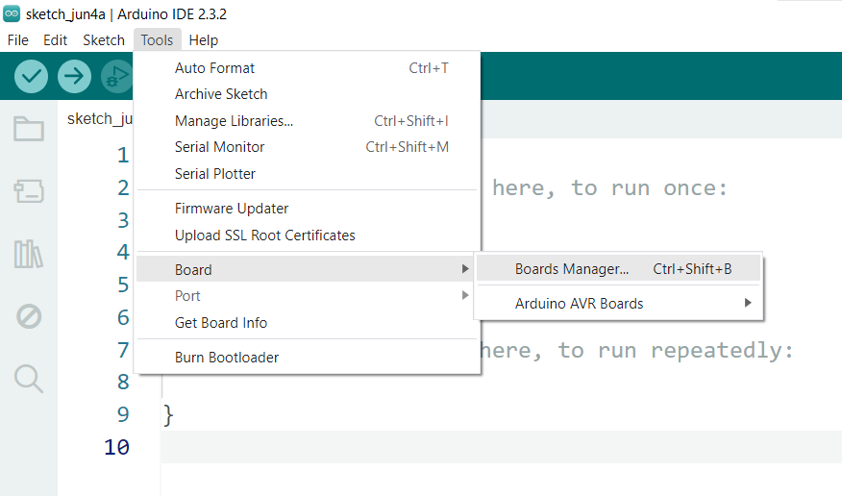
Open the Boards Manager (Tools > Board > Boards Manager)

Slide 13
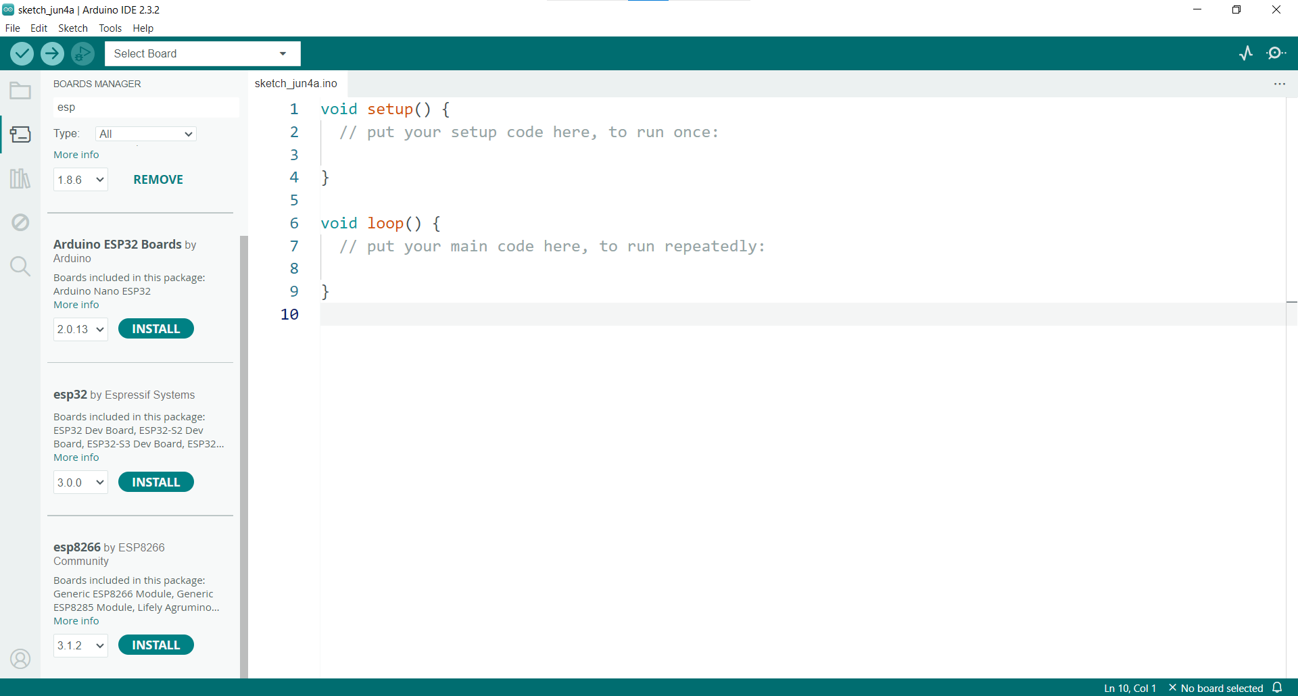
Search esp and install esp32 ja esp8266

Slide 14
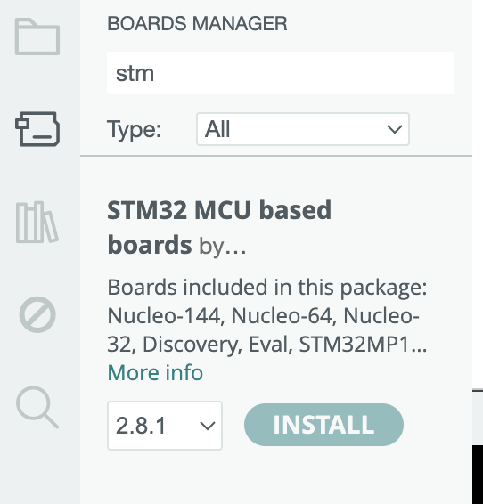
Let’s add STM…

Slide 15
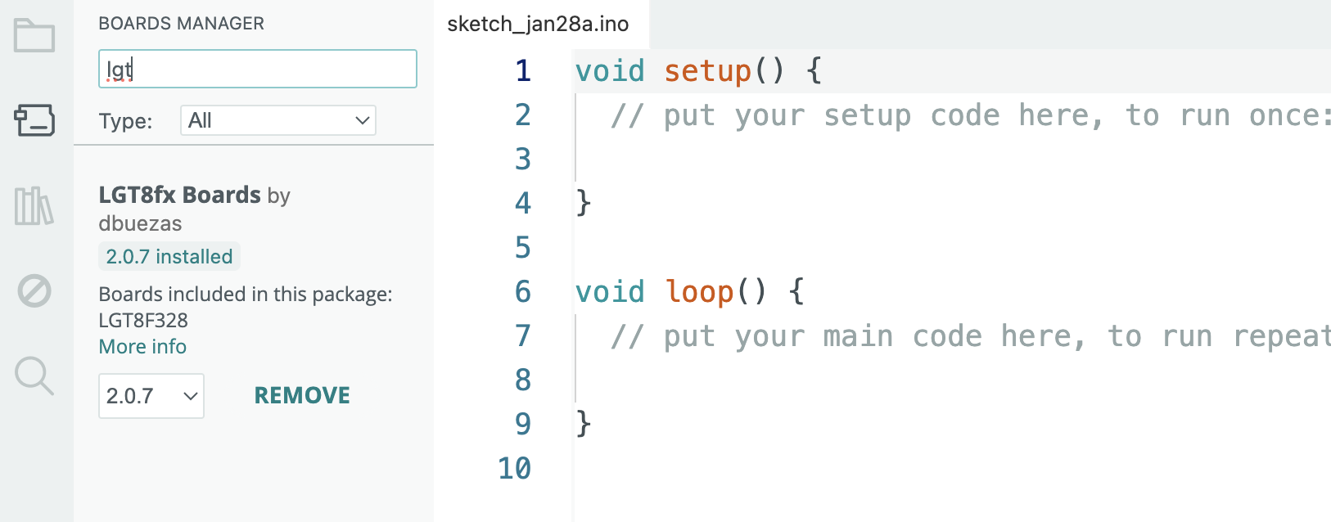
Install UNO- clones that are cheaper

Slide 16
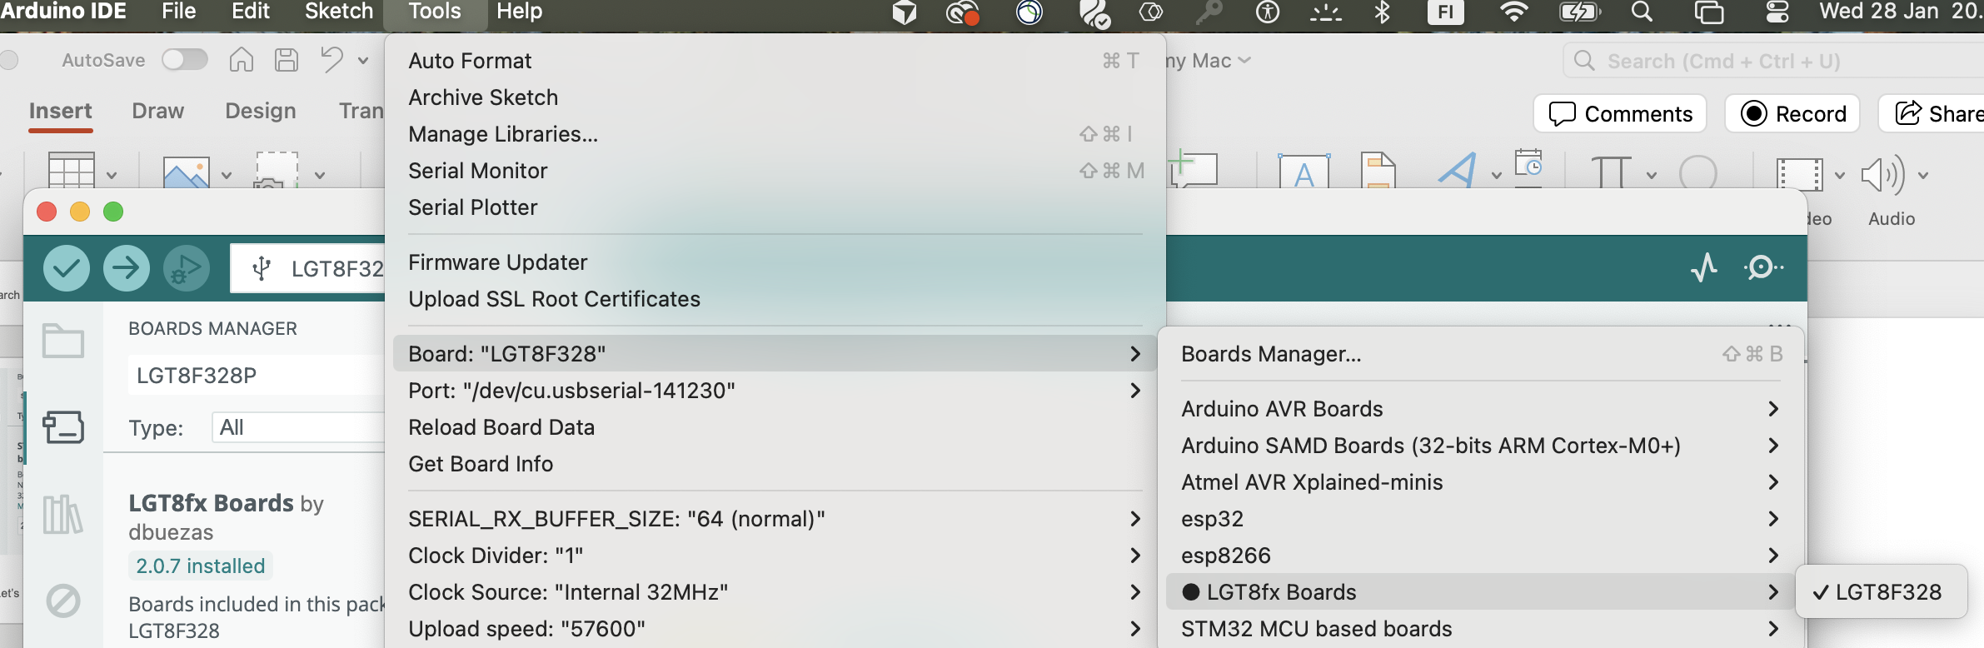
If you use cheaper UNO – clone don’t forget to select right board

Slide 17
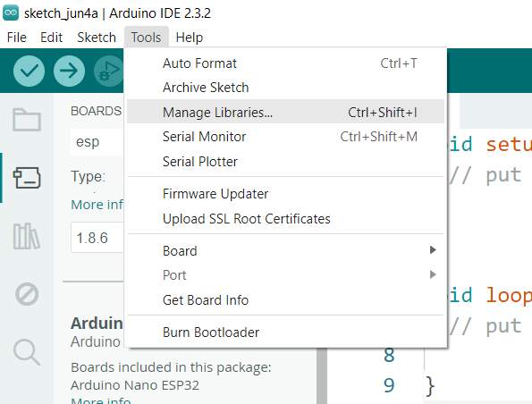
Open Manage libraries from the menu (Tools > Manage Libraries)

Slide 18
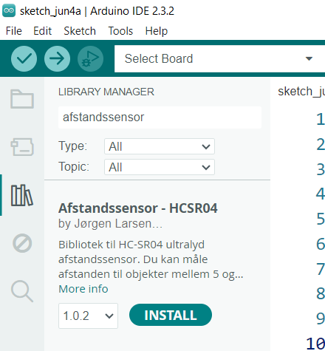
Search afstandssensor and install it

Slide 19
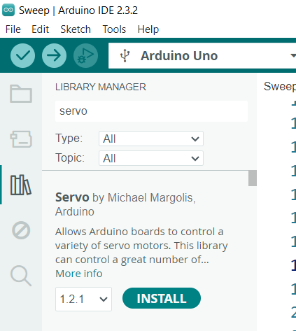
Search servo and install it

Slide 20
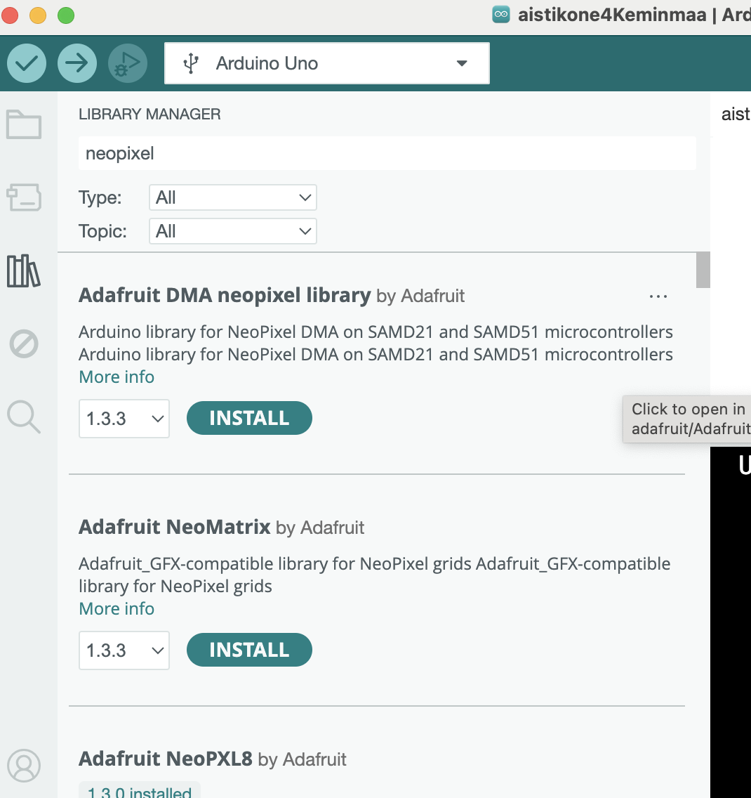
Search Adafruit neopixel and install it

Slide 21
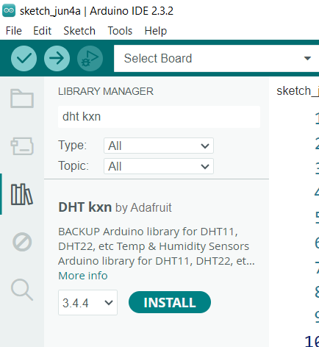
And search dht kxn and install it...

Slide 22
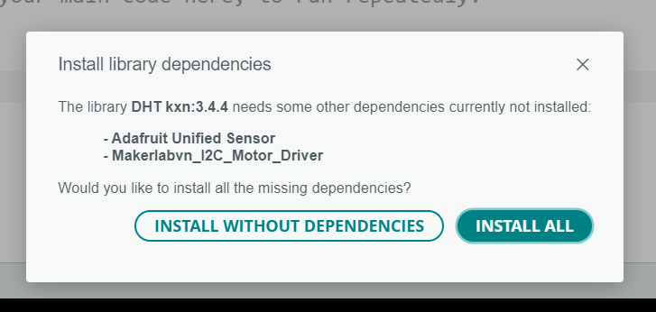
Click INSTALL ALL

Slide 23
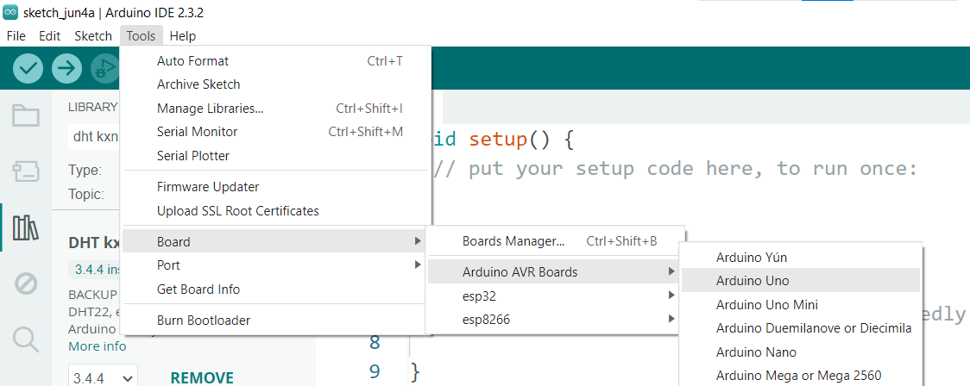
Select Arduino Uno from the menu (Tools > Board > Arduino AVR Boards > Arduino Uno)

Slide 24
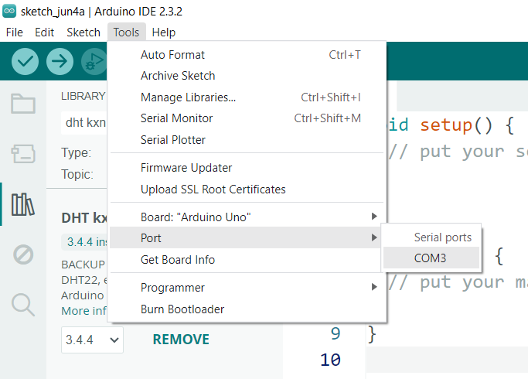
Select COM3 (Tools > Port > COM3)

Slide 25
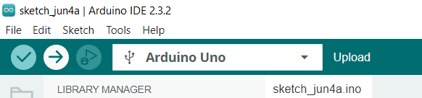
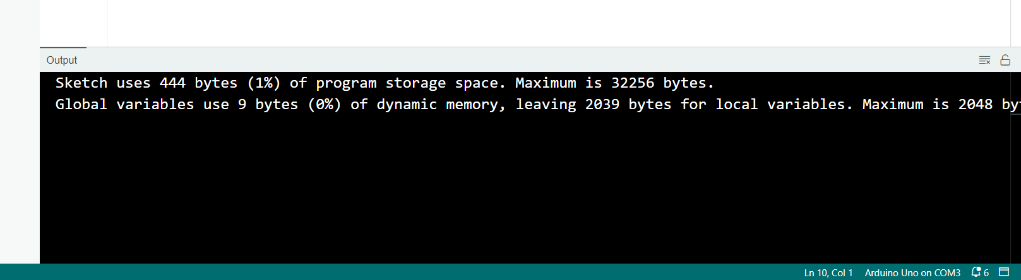
Click the upload button

Slide 26
Other libraries recommended for installation:
Adafruit_BMP085_U.h
ESP8266WiFi.h
OneWire.h
DallasTemperature.h
Adafruit_MPU6050.h
Adafruit_Sensor.h

Slide 27
Other: In case you want to learn more programming
Install also processing?
Optional not required

Slide 28
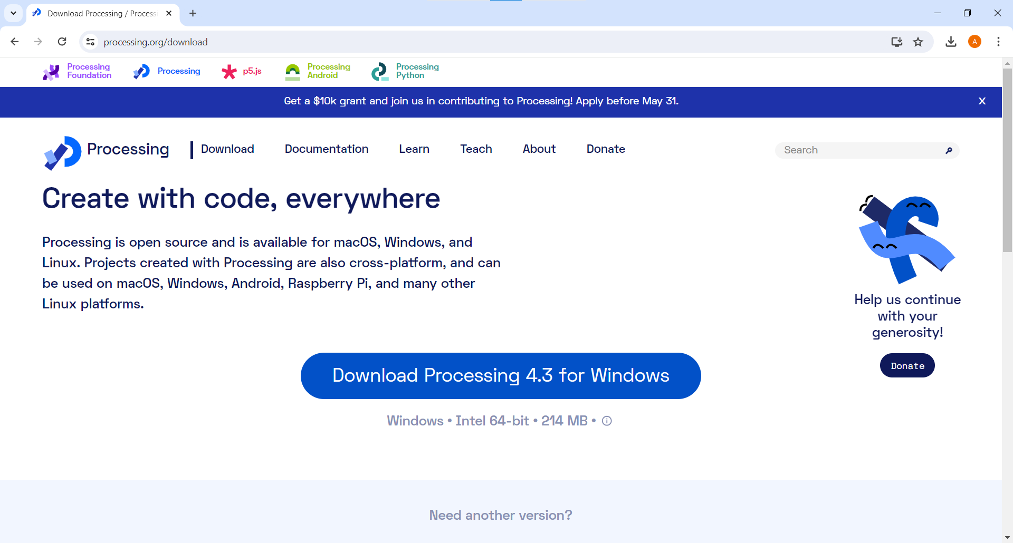
Go to URL processing.org/download and download Processing

Slide 29
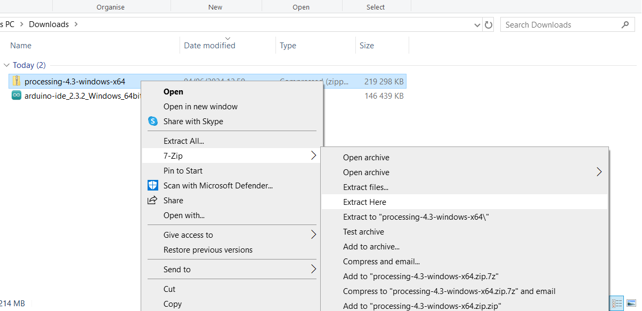
Extract the compressed file using the right mouse button (7-Zip > Extract Here )

Slide 30
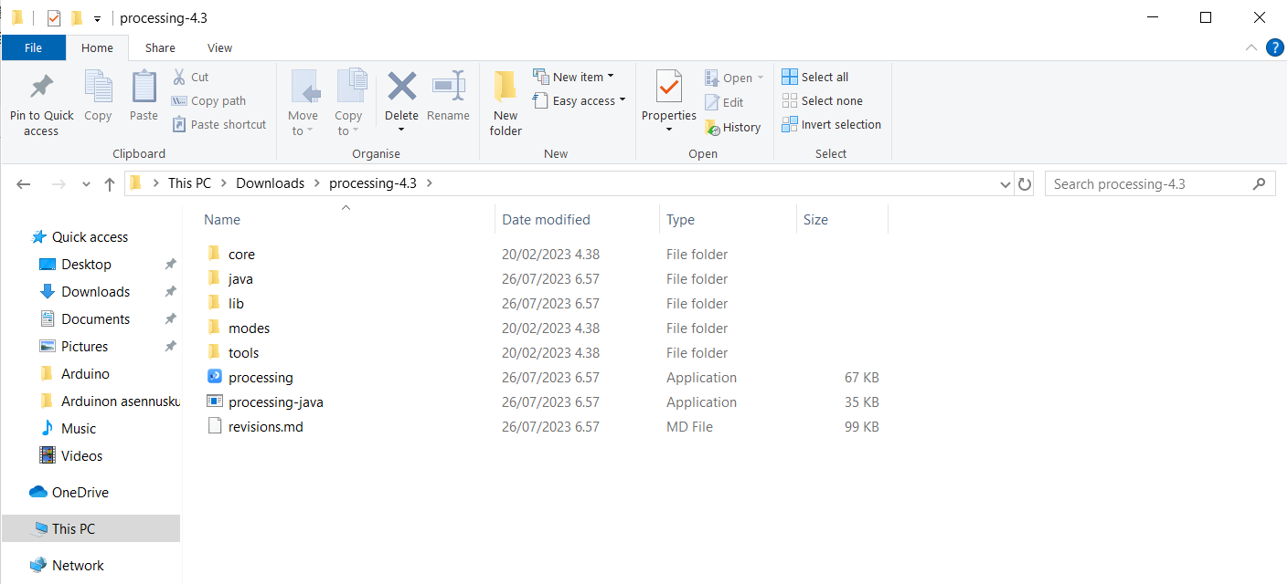
Open the processing-4.3 folder

